Slide 1

Introduction to TensorFlow 2.0
Presented by:
Elizer Ponio Jr.
Department of Computer Science
College of Computing and Information Technologies

Slide 2
Outline
What is TensorFlow?
What is a Tensor?
TensorFlow Architecture

Slide 3


TensorFlow
TensorFlow 2.0 is a library that provides a comprehensive ecosystem of tools for developers, researchers, and organizations who want to build scalable Machine Learning and Deep Learning applications.
TensorFlow is a popular open-source library released in 2015 by the Google Brain team for building machine learning and deep learning models.
It is based on Python programming language and performs numerical computations using data flow graphs to build models.

Slide 4

TensorFlow Applications
Face detection
Machine Translation
Fraud detection
Object detection

Slide 5
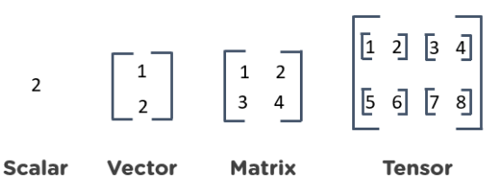
What is a Tensor?
TensorFlow is derived from its core component known as a tensor.
A tensor is actually a vector or a matrix of n-dimensions that represents all types of data.

Slide 6
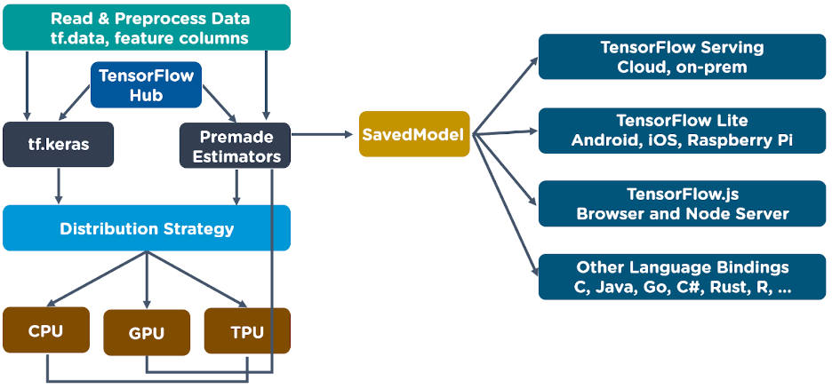
TensorFlow Architecture

